Slide 1
AC Circuits
The Circuit Elements in The Phasor Domain
By Dr. Ahmed S. Abdullah
د. احمد سليمان عبدالله

Slide 2
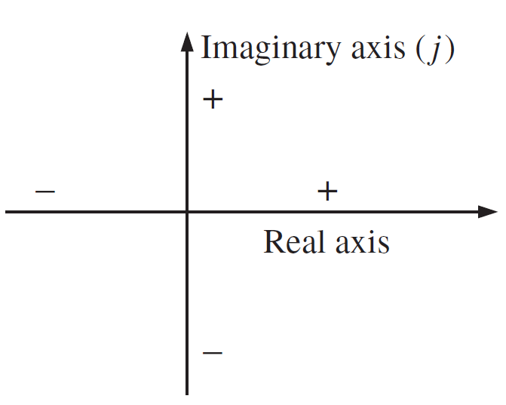
Complex Numbers
A complex number represents a point in a two-dimensional plane located with reference to two distinct axes. This point can also determine a radius vector drawn from the origin to the point. The horizontal axis is called the real axis, while the vertical axis is called the imaginary axis.

Slide 3
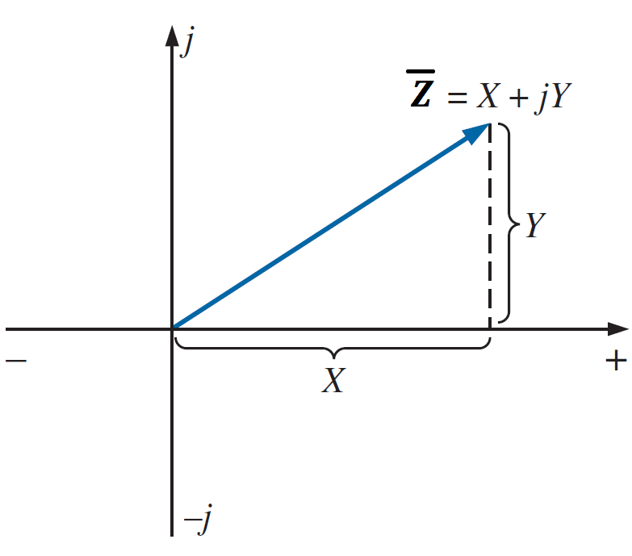
Complex Numbers
Rectangular Form
The format for the rectangular form is
Where
$\overline{Z}$ is the complex number
X is the real part of Z (Re(Z))
Y is the imaginary part of Z (Im(Z))
j $= \sqrt{−1}$

Slide 4
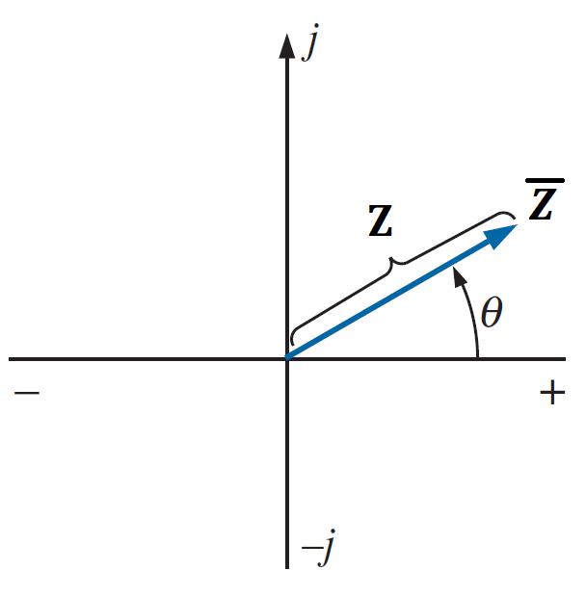
Complex Numbers
Polar Form
The format for the Polar form is
Where
Z is the magnitude of $\overline{Z}$
$θ$ is the angle of $\overline{Z}$ with the real axis

Slide 5
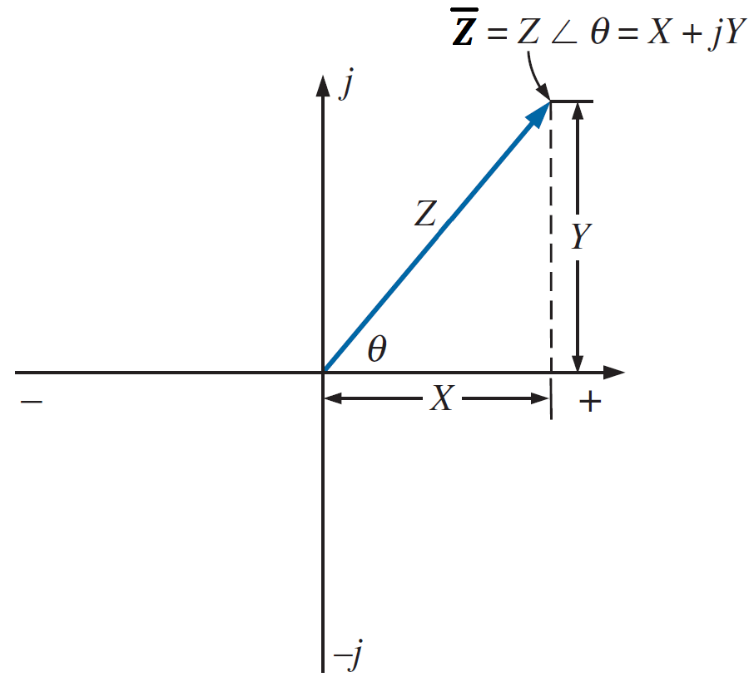
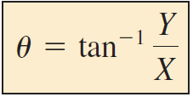
Complex Numbers
Conversion Between Forms
Rectangular to Polar

Slide 6
Complex Numbers
Conversion Between Forms
Rectangular to Polar
EXAMPLE : Convert the following from rectangular to polar form:
$$\overline{Z}=3+j4$$
$$Z=\sqrt{3^{2}+4^{2}}=\sqrt{25}=5$$
$$θ=\tan^{−1}\frac{4}{3}={53.13}^{o}$$
$\overline{Z_{1}}=Z ∠θ=5 ∠$ ${53.13}^{o}$

Slide 7
Complex Numbers
Conversion Between Forms
Polar to Rectangular

Slide 8
Complex Numbers
Conversion Between Forms
Polar to Rectangular
EXAMPLE : Convert the following from polar to rectangular form:
$\overline{Z_{1}}=5 ∠$ ${53.13}^{o}$
$$X=5 cos{ (53.13}^{o})=3$$
$$Y=5 sin{ (53.13}^{o})=4$$
$$\overline{Z}=X+jY=3+j4$$

Slide 9
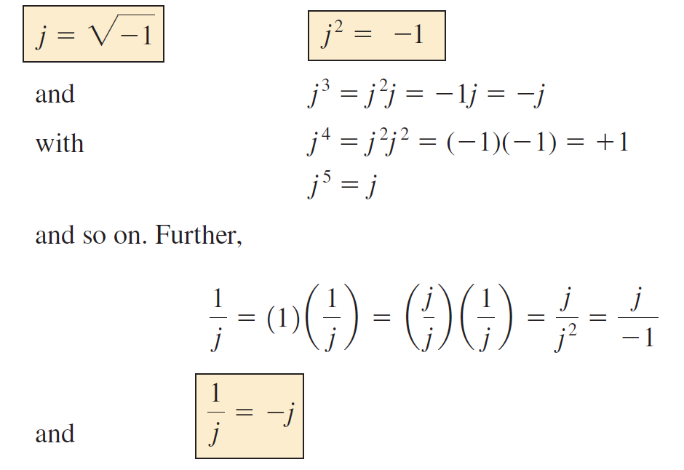
Complex Numbers
Mathematical Operations With Complex Numbers

Slide 10
Complex Numbers
Mathematical Operations With Complex Numbers
Addition and Subtraction
$$Z_{1}=X_{1}+jY_{1}$$
$$Z_{2}=X_{2}+jY_{2}$$
$$Z_{1}+Z_{2}=\left(X_{1}+X_{2}\right)+j(Y_{1}+Y_{2})$$
$$Z_{1}−Z_{2}=\left(X_{1}−X_{2}\right)+j(Y_{1}−Y_{2})$$

Slide 11
Complex Numbers
Mathematical Operations With Complex Numbers
Addition and Subtraction
$$Z_{1}=2+j4$$
$$Z_{2}=3+j1$$
$$Z_{1}+Z_{2}=\left(2+3\right)+j\left(4+1\right)=5+j5$$
$$Z_{1}−Z_{2}=\left(2−3\right)+j\left(4−1\right)=−1+j3$$

Slide 12
Complex Numbers
Mathematical Operations With Complex Numbers
Addition and Subtraction
Addition or subtraction cannot be performed in polar form unless the complex numbers have the same angle $θ$ or unless they differ only by multiples of 180°.
$$Z_{1}=2 ∠{45}^{o}$$
$$Z_{2}=3 ∠{45}^{o}$$
$$Z_{1}+Z_{2}=5 ∠{45}^{o}$$

Slide 13
Complex Numbers
Mathematical Operations With Complex Numbers
Multiplication
Rectangular
$$Z_{1}=X_{1}+jY_{1}$$
$$Z_{2}=X_{2}+jY_{2}$$
$Z_{1}$. $Z_{2}=(X_{1}+jY_{1})(X_{2}+jY_{2})$
$Z_{1}$. $Z_{2}=X_{1}X_{2}+jX_{1}Y_{2}$+${jY_{1}X}_{2}−{Y_{1}Y}_{2}$
$Z_{1}$. $Z_{2}={(X}_{1}X_{2}−{Y_{1}Y}_{2})+j(X_{1}Y_{2}$+${Y_{1}X}_{2})$

Slide 14
Complex Numbers
Mathematical Operations With Complex Numbers
Multiplication
Rectangular
$$Z_{1}=2+j3$$
$$Z_{2}=5+j10$$
$Z_{1}$. $Z_{2}=(2+j3)(5+j10)$
$Z_{1}$. $Z_{2}=(2)(5)+j(2)(10)+j(3)(5)−(3)(10)$
$Z_{1}$. $Z_{2}=(10−30)+j(20+15)$
$$=−20+j35$$

Slide 15
Complex Numbers
Mathematical Operations With Complex Numbers
Multiplication
Polar
$$\overline{Z_{1}}=Z_{1} ∠θ_{1}$$
$$\overline{Z_{2}}=Z_{2} ∠θ_{2}$$
$\overline{Z_{1}}$. $\overline{Z_{2}}=Z_{1}Z_{2 }∠θ_{1}$+ $θ_{2}$

Slide 16
Complex Numbers
Mathematical Operations With Complex Numbers
Multiplication
Polar
$$\overline{Z_{1}}=5 ∠{20}^{o}$$
$$\overline{Z_{2}}=10 ∠{30}^{o}$$
$\overline{Z_{1}}$. $\overline{Z_{2}}=Z_{1}Z_{2 }∠θ_{1}$+ $θ_{2}$
$Z_{1}$. $Z_{2}=(5) (10)∠{20}^{o}$+${30}^{o}$
$Z_{1}$. $Z_{2}=50∠{50}^{o}$

Slide 17
Complex Numbers
Mathematical Operations With Complex Numbers
Division
Rectangular
$$Z_{1}=X_{1}+jY_{1}$$
$$Z_{2}=X_{2}+jY_{2}$$
$$\frac{Z_{1}}{Z_{2}}=\frac{X_{1}+jY_{1}}{X_{2}+jY_{2}}$$
We rationalize the denominator by multiplying both the numerator and denominator by ${Z_{2}}^{∗}$
$${Z_{2}}^{∗}=X_{2}−jY_{2}$$

Slide 18
Complex Numbers
Mathematical Operations With Complex Numbers
Division
Rectangular
$$Z_{1}=X_{1}+jY_{1}$$
$$Z_{2}=X_{2}+jY_{2}$$
$$\frac{Z_{1}}{Z_{2}}=\frac{X_{1}+jY_{1}}{X_{2}+jY_{2}}×\frac{X_{2}−jY_{2}}{X_{2}−jY_{2}}$$
$$\frac{Z_{1}}{Z_{2}}=$$

Slide 19
Complex Numbers
Mathematical Operations With Complex Numbers
Division
Rectangular
$$Z_{1}=1+j4$$
$$Z_{2}=4+j5$$

Slide 20
Complex Numbers
Mathematical Operations With Complex Numbers
Division
Rectangular
$$Z_{1}=1+j4$$
$$Z_{2}=4+j5$$
$$\frac{Z_{1}}{Z_{2}}=\frac{1+j4}{4+j5}×\frac{4−j5}{4−j5}$$

Slide 21
Complex Numbers
Mathematical Operations With Complex Numbers
Division
Rectangular
$$Z_{1}=1+j4$$
$$Z_{2}=4+j5$$
$$\frac{Z_{1}}{Z_{2}}=\frac{1+j4}{4+j5}×\frac{4−j5}{4−j5}$$
$$\frac{Z_{1}}{Z_{2}}=\frac{\left(1\right)\left(4\right)+(4)(5)}{4^{2}+5^{2}}+j\frac{(4)(4)−(1)(5)}{4^{2}+5^{2}}$$

Slide 22
Complex Numbers
Mathematical Operations With Complex Numbers
Division
Rectangular
$$Z_{1}=1+j4$$
$$Z_{2}=4+j5$$
$$\frac{Z_{1}}{Z_{2}}=\frac{\left(4\right)+(20)}{16+25}+j\frac{(16)−(5)}{16+25}$$

Slide 23
Complex Numbers
Mathematical Operations With Complex Numbers
Division
Rectangular
$$Z_{1}=1+j4$$
$$Z_{2}=4+j5$$
$$\frac{Z_{1}}{Z_{2}}=\frac{24}{41}+j\frac{11}{41}≅0.59+j0.27$$

Slide 24
Complex Numbers
Mathematical Operations With Complex Numbers
Division
Polar
$$\overline{Z_{1}}=Z_{1} ∠θ_{1}$$
$$\overline{Z_{2}}=Z_{2} ∠θ_{2}$$
$\frac{\overline{Z_{1}}}{\overline{Z_{2}}}=\frac{Z_{1}}{Z_{2}}∠θ_{1}−$ $θ_{2}$

Slide 25
Complex Numbers
Mathematical Operations With Complex Numbers
Division
Polar
$$\overline{Z_{1}}=15 ∠{10}^{o}$$
$$\overline{Z_{2}}=2 ∠7^{o}$$
$\frac{\overline{Z_{1}}}{\overline{Z_{2}}}=\frac{Z_{1}}{Z_{2}}∠θ_{1}−$ $θ_{2}$
$$\frac{\overline{Z_{1}}}{\overline{Z_{2}}}=\frac{15}{2}∠{10}^{o}−7^{o}=7.5∠ 3^{o}$$

Slide 26
References
Boylestad, Robert L. Introductory circuit analysis. Pearson Education, 2010.
Robbins, Allan H., and Wilhelm C. Miller. Circuit analysis: Theory and practice. Cengage Learning, 2012.
Sadiku, Matthew NO, and Chales K. Alexander. Fundamentals of electric circuits. McGraw-Hill Higher Education, 2007.

